Slide 1


Fundamentals of Testing
ISTQB Certification Program
What is Testing?

Slide 2

What is Testing?
Why is Testing necessary?
Q&A
Agenda

Slide 3
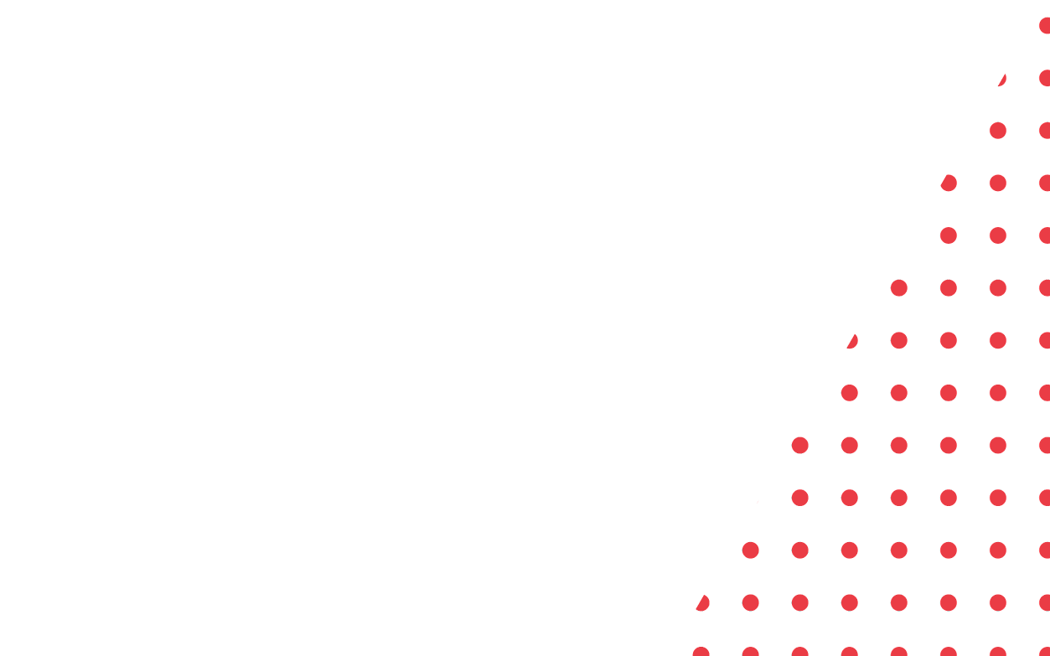
What is Testing?

Slide 4
What is not:
A common misperception of testing is that it only consists of running tests.
Just validate something works.

Slide 5

What really is:
Software testing is a PROCESS. The test process also includes activities such as:
Test planning
Analyzing, designing and implementing tests
Reporting test progress and results
Evaluating the quality of a test object.

Slide 6

Typical Objectives of Testing
To prevent defects.
To verify whether all specified requirements have been fulfilled.
Validate if it works as the users and other stakeholders expect.
To build confidence in the level of quality of the test object.

Slide 7
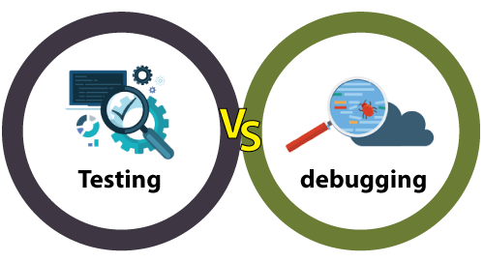
Testing and debugging
Testing and debugging are not the same!
TESTING:
Executing tests to show failures that are caused by defects in the software.
DEBUGGING:
Is the development activity that finds, analyzes, and fixes such defects

Slide 8
Why is Testing necessary?
Testing can help reduce the risk of failures occurring during operation.
When defects are detected, and subsequently fixed, this contributes to the quality of the components or systems.
May also be required to meet contractual or legal requirements or industry-specific standards.

Slide 9
Testing’s contributions to success
Reduce defects at early stages.
Reduce the risk of fundamental design defects.
Increase each party’s understanding of the code.
Increases the likelihood that the software meets stakeholder needs
and satisfies requirements.

Slide 10

Quality Assurance and Testing
Quality assurance and testing are not the same.
TESTING: Is a Process.
QA: Is typically focused on adherence to proper processes.

Slide 11
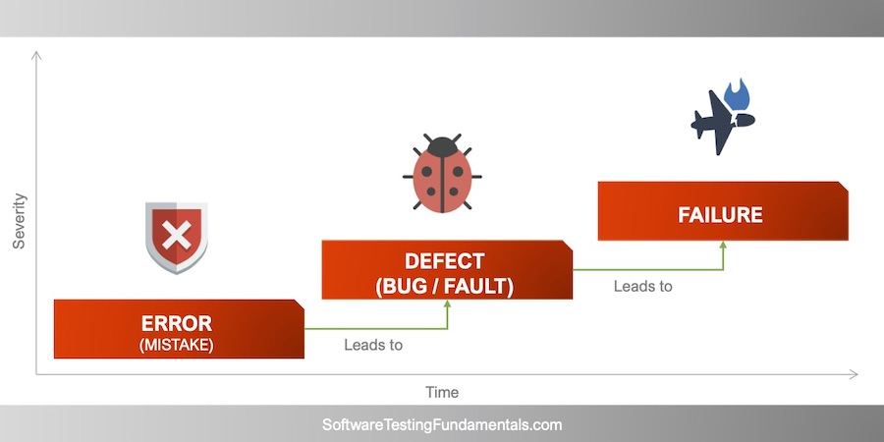
Error, Defects, and Failures
A person can make an error (mistake), which can lead to the introduction of a defect (fault or bug) in the software code or in some other related work product.
If a defect in the code is executed, this may cause a failure.

Slide 12
Defects, Root Causes and Effects
Typo
Misunderstanding
User can not buy a product
Root Causes
Effects
Defect
The page does not load.
Wrong UI fields

Slide 13
Q & E

